Slide 1
Digital Image Processing
Lecture7: Relationships between pixels

Slide 2
In this lecture, we consider several important relationships between pixels in a digital image.

Slide 3
Neighbors of a Pixel
A pixel p at coordinates (x,y) has four horizontal and vertical neighbors whose coordinates are given by:
(x+1,y), (x-1, y), (x, y+1), (x,y-1)
This set of pixels, called the 4-neighbors or p, is denoted by N₄(p). Each pixel is one unit distance from (x,y) and some of the neighbors of p lie outside the digital image if (x,y) is on the border of the image.
 | (x, y-1)
(x-1, y) | P (x,y) | (x+1, y)
 | (x, y+1)

Slide 4
Neighbors of a Pixel
The four diagonal neighbors of p have coordinates:
(x+1, y+1), (x+1, y-1), (x-1, y+1), (x-1, y-1)
and are denoted by N_{D} (p).
These points, together with the 4-neighbors, are called the 8-neighbors of p, denoted by N₈ (p).
As before, some of the points in N_{D} (p) and N₈ (p) fall outside the image if (x,y) is on the border of the image.
(x-1, y+1) |  | (x+1, y-1)
 | P (x,y)
(x-1, y-1) |  | (x+1, y+1)
(x-1, y+1) | (x, y-1) | (x+1, y-1)
(x-1, y) | P (x,y) | (x+1, y)
(x-1, y-1) | (x, y+1) | (x+1, y+1)

Slide 5
Adjacency and Connectivity
Let V: a set of intensity values used to define adjacency and connectivity.
In a binary image, V = {1}, if we are referring to adjacency of pixels with value 1.
In a gray-scale image, the idea is the same, but V typically contains more elements, for example, V = {180, 181, 182, …, 200}
If the possible intensity values 0 – 255, V set can be any subset of these 256 values.

Slide 6
Types of Adjacency
4-adjacency: Two pixels p and q with values from V are 4-adjacent if q is in the set N₄(p).
8-adjacency: Two pixels p and q with values from V are 8-adjacent if q is in the set N₈(p).
m-adjacency =(mixed)

Slide 7
Types of Adjacency
m-adjacency:
Two pixels p and q with values from V are m-adjacent if :
q is in N₄(p) or
q is in N_{D}(p) and the set N₄(p) ∩ N₄(q) has no pixel whose values are from V (no intersection)
Important Note: the type of adjacency used must be specified

Slide 8
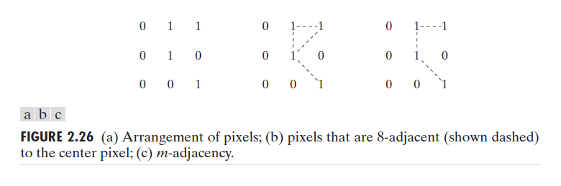
Types of Adjacency
Mixed adjacency is a modification of 8-adjacency. It is introduced to eliminate the ambiguities that often arise when 8-adjacency is used.
For example:

Slide 9
Types of Adjacency
In this example, we can note that to connect between two pixels (finding a path between two pixels):
In 8-adjacency way, you can find multiple paths between two pixels
While, in m-adjacency, you can find only one path between two pixels
So, m-adjacency has eliminated the multiple path connection that has been generated by the 8-adjacency.
Two subsets S1 and S2 are adjacent, if some pixel in S1 is adjacent to some pixel in S2. Adjacent means, either 4-, 8- or m-adjacency.

Slide 10
A Digital Path
A digital path (or curve) from pixel p with coordinate (x,y) to pixel q with coordinate (s,t) is a sequence of distinct pixels with
Coordinates (x₀,y₀), (x₁,y₁), …, (x_{n}, y_{n}) where
(x₀,y₀) = (x,y) and (x_{n}, y_{n}) = (s,t) and pixels (x_{i}, y_{i}) and (x_{i-1}, y_{i-1}) are adjacent for 1 ≤ i ≤ n
n is the length of the path
If (x₀,y₀) = (x_{n}, y_{n}), the path is closed.
We can specify 4-, 8- or m-paths depending on the type of adjacency specified.

Slide 11
A Digital Path
Return to the previous example:
In figure (b) the paths between the top right and bottom right pixels are 8-paths. And the path between the same 2 pixels in figure (c) is m-path

Slide 12
Connectivity
Let S represent a subset of pixels in an image, two pixels p and q are said to be connected in S if there exists a path between them consisting entirely of pixels in S.
For any pixel p in S, the set of pixels that are connected to it in S is called a connected component of S. If it only has one connected component, then set S is called a connected set.

Slide 13
Region and Boundary
Region
Let R be a subset of pixels in an image, we call R a region of the image if R is a connected set.
Boundary
The boundary (also called border or contour) of a region R is the set of pixels in the region that have one or more neighbors that are not in R.

Slide 14
Region and Boundary
If R happens to be an entire image, then its boundary is defined as the set of pixels in the first and last rows and columns in the image.
This extra definition is required because an image has no neighbors beyond its borders
Normally, when we refer to a region, we are referring to subset of an image, and any pixels in the boundary of the region that happen to coincide with the border of the image are included implicitly as part of the region boundary.

Slide 15
Distance Measures
For pixels p, q and z, with coordinates (x,y), (s,t) and (v,w), respectively, D is a distance function if:
(a) D (p,q) ≥ 0 (D (p,q) = 0 iff p = q),
(b) D (p,q) = D (q, p), and
(c) D (p,z) ≤ D (p,q) + D (q,z).

Slide 16
Distance Measures
The Euclidean Distance between p and q is defined as:
D_{e} (p,q) = [(x – s)² + (y - t)²]^{1/2}
Pixels having a distance less than or equal
to some value r from (x,y) are the points
^{contained in a disk of}
^{radius r centered at (x,y)}
q (s,t)
D_{e} (p,q)
p (x,y)

Slide 17
Distance Measures
The D₄ distance (also called city-block distance) between p and q is defined as:
D₄ (p,q) = | x – s | + | y – t |
Pixels having a D₄ distance from
(x,y), less than or equal to some
value r form a Diamond
centered at (x,y)
q (s,t)
D₄
p (x,y)

Slide 18
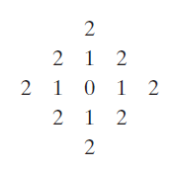
Distance Measures
Example:
The pixels with distance D₄ ≤ 2 from (x,y) form the following contours of constant distance.
The pixels with D₄ = 1 are
the 4-neighbors of (x,y)

Slide 19
Distance Measures
The D₈ distance (also called chessboard distance) between p and q is defined as:
D₈ (p,q) = max(| x – s |,| y – t |)
Pixels having a D₈ distance from
(x,y), less than or equal to some
value r form a square
Centered at (x,y)
q (s,t)
D_{8(b)}
p (x,y)
D_{8(a)}
D₈ = max(D_{8(a) ,} D_{8(b)})

Slide 20
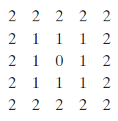
Distance Measures
Example:
D₈ distance ≤ 2 from (x,y) form the following contours of constant distance.

Slide 21
Distance measures
Ch3: Some basic Relationships between pixels
Euclidean distance between p and q:
De(p,q) = [(x-s)² + (y-t)²]^{1/2}
D4 distance (also called city-block distance):
D4(p,q) = |x-s| + |y-t|
D8 distance (also called chessboard distance) :
D8(p,q) = max (|x-s| , |y-t|)

Slide 22
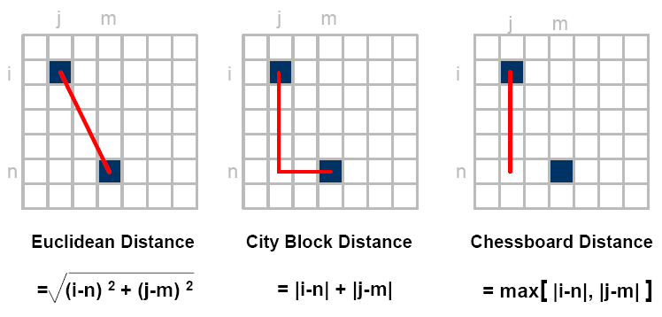
Distance measures

Slide 23
Example:
Compute the distance between the two pixels using the three distances :
q:(1,1)
P: (2,2)
Euclidian distance : ((1-2)²+(1-2)²)^{1/2} = sqrt(2).
D4(City Block distance): |1-2| +|1-2| =2
D8(chessboard distance ) : max(|1-2|,|1-2|)= 1
(because it is one of the 8-neighbors )
1 2 3
 |  | q
 | p
1
2 3

Slide 24
Distance measures
Example :
Use the city block distance to prove 4-neighbors ?
Pixel A : | 2-2| + |1-2| = 1
Pixel B: | 3-2|+|2-2|= 1
Pixel C: |2-2|+|2-3| =1
Pixel D: |1-2| + |2-2| = 1
Now as a homework try the chessboard distance to proof the 8- neighbors!!!!
1 2 3
1
2
3
 | d
c | p | a
 | b

Slide 25
Distance Measures
Dm distance:
is defined as the shortest m-path between the points.
In this case, the distance between two pixels will depend on the values of the pixels along the path, as well as the values of their neighbors.

Slide 26

Distance Measures
Example:
Consider the following arrangement of pixels and assume that p, p₂, and p₄ have value 1 and that p₁ and p₃ can have can have a value of 0 or 1
Suppose that we consider
the adjacency of pixels
values 1 (i.e. V = {1})

Slide 27

Distance Measures
Cont. Example:
Now, to compute the D_{m} between points p and p₄
Here we have 4 cases:
Case1: If p₁ =0 and p₃ = 0
The length of the shortest m-path
(the D_{m} distance) is 2 (p, p₂, p₄)

Slide 28

Distance Measures
Cont. Example:
Case2: If p₁ =1 and p₃ = 0
now, p₁ and p will no longer be adjacent (see m-adjacency definition)
then, the length of the shortest
path will be 3 (p, p₁, p₂, p₄)

Slide 29

Distance Measures
Cont. Example:
Case3: If p₁ =0 and p₃ = 1
The same applies here, and the shortest –m-path will be 3 (p, p₂, p₃, p₄)

Slide 30

Distance Measures
Cont. Example:
Case4: If p₁ =1 and p₃ = 1
The length of the shortest m-path will be 4 (p, p₁ , p₂, p₃, p₄)

